Slide 1
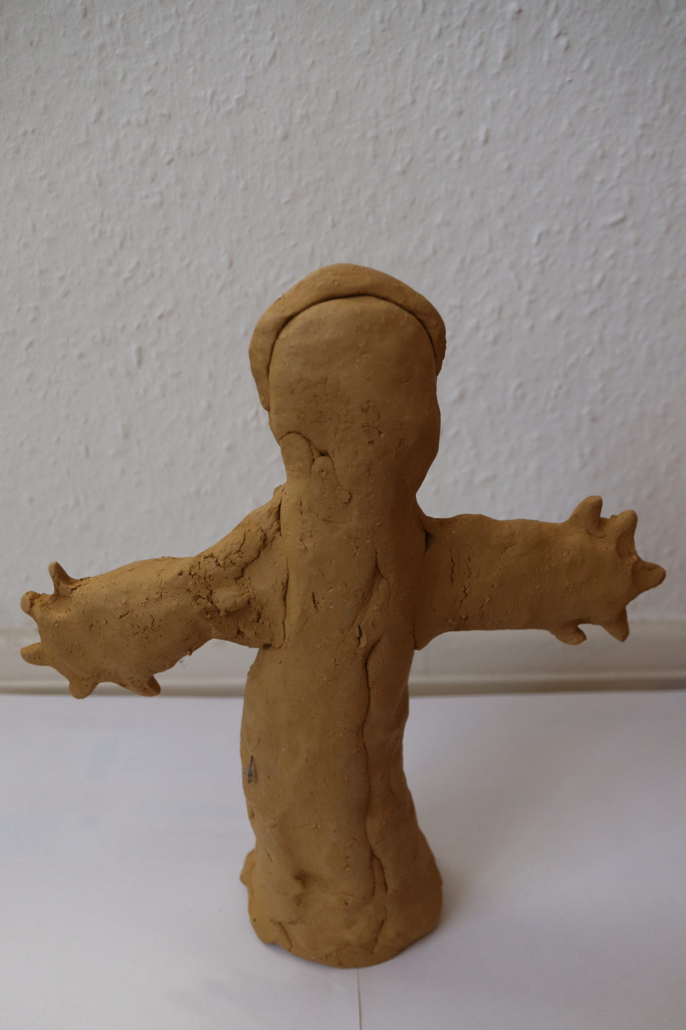
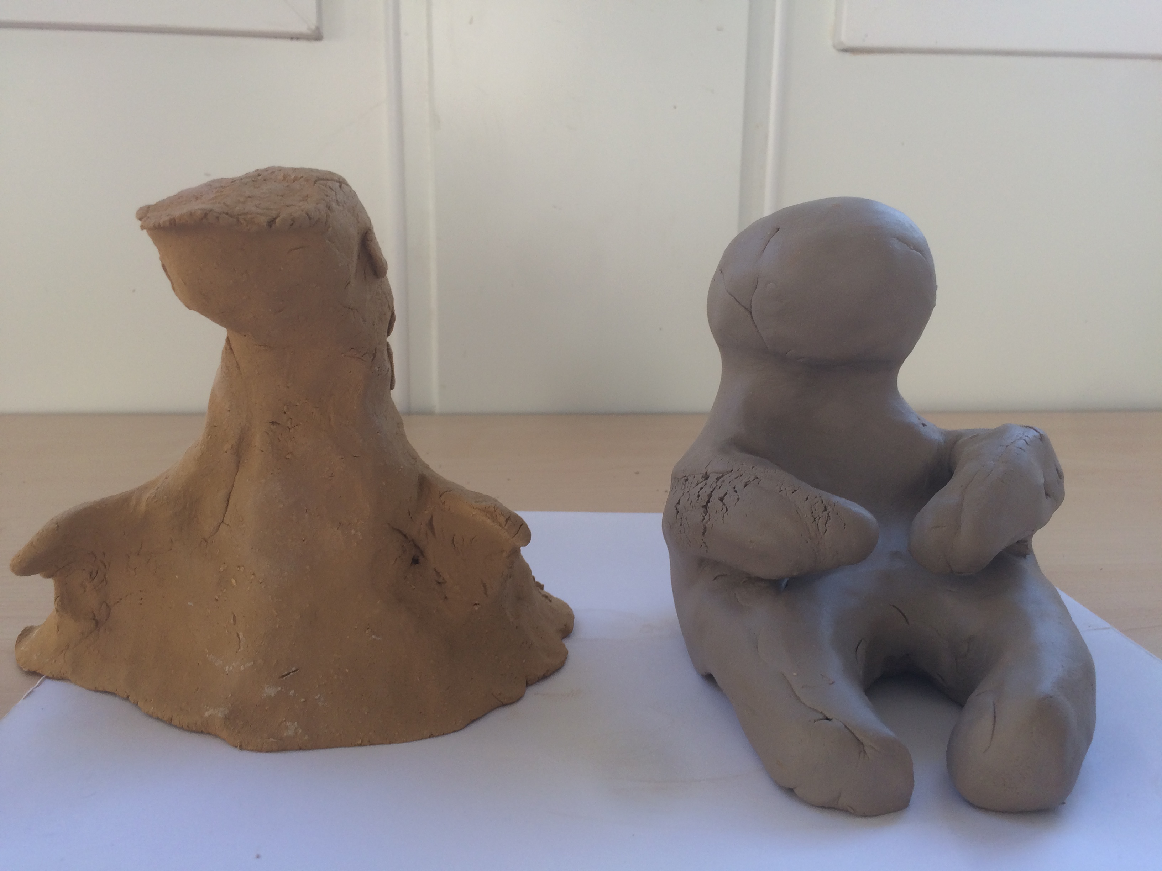
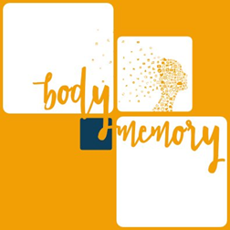
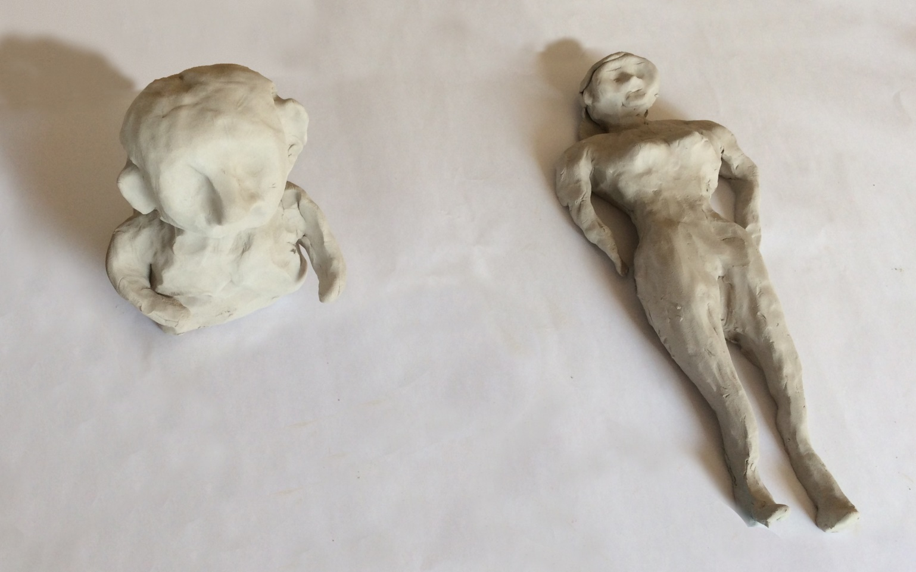
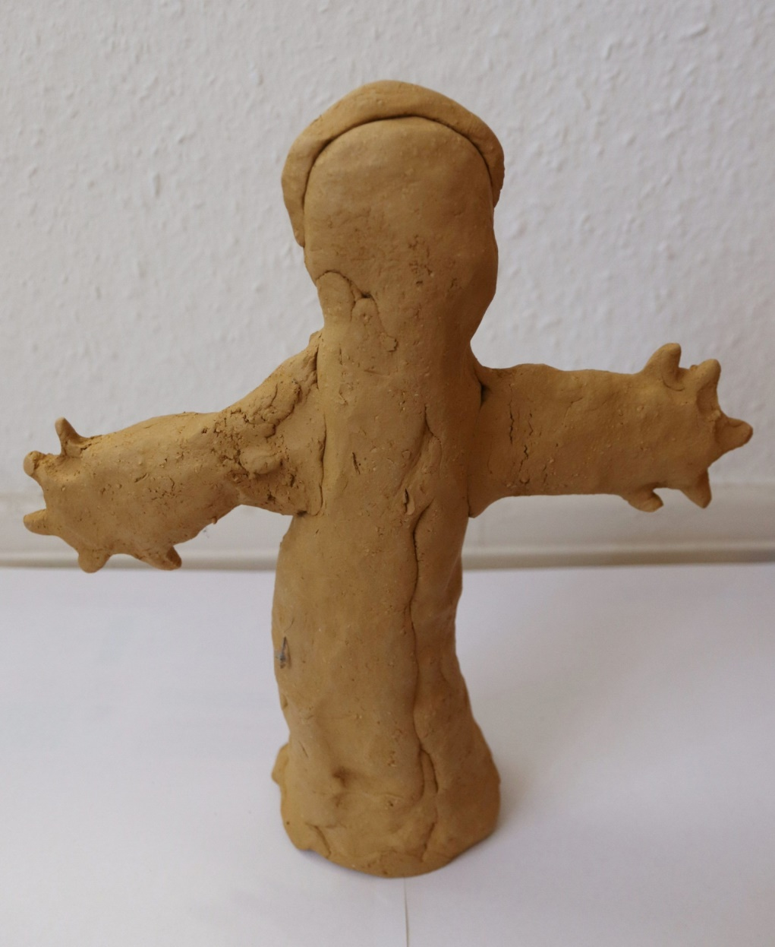
War and Flight leave traces in the Body Memory of refugees but they are not irreversible
Beatrice Schlee¹ PhD, Prof. Mone Welsche, Lucie Stolwijk (BA), Clara Holling, Tahira Aslan;
University of Freiburg, Arnold-Bergstraesser Institut, Catholic University of Applied Sciences, Germany
Results
Methods
From among the different research instruments used, the body-sculpture test emerged as the most powerful one to tell the participant’s bodily narrative. Each sculpture tells a story of ‘lived experiences’, of strengths and vulnerabilities. The fact that the body sculptures were getting “more alive and more differentiated” was mirrored by the questionnaires with rising vitality and intrapsychic equilibrium criteria, (X %), the movement observation (more flexibility, free flow and far reaching movements through space) as well as by the interviews where participants stated that they felt much stronger and more energized to cope with their daily challenges . Body image sculptures with missing body parts or oversized heads and “frozen bodies” where hyperarousal is hold as it has not found its motoric equivalence (van der Kolk 2015) are frequent in refugee sculptures. There are strong indications that trauma has negative impacts on the body image and thereby the agency of refugees.
Methods used: semi-structured interviews, questionnaires, body image sculpture test, movement observation
Basler Inner States Scale (BBS, Hobi, 1985)
Measure the current inner state of a person (16 items), two of four sub-dimensions:
Vitality (invigorated – weak)
Intrapsychic equilibrium state (confident – insecure)
The range of scores is between 16 (`highly inactive´) and 80 (`highly active´).
Body Image Questionnaire (FKB 20, Clement & Loewe, 1996) , 20 items. 2 scales: `negative body evaluation´ (AKB) ,`vital body dynamic´ (VKD)
pre
post
Fig. 1 Body image of female refugee before and after the intervention
Intervention
8 weekly sessions (90 min.) of Body-Mind Centering®
Focus on body sensitivity and body awareness through bone tracing
Grounding and whole-body experiences through basic neurocellular patterns
Enlarge movement space (kinesphere)
Exploring the thorax and lungs (Bainbridge-Cohen, 2012).
From frozen to agent bodies
Example frozen bodies
“…in the course I realized that I am here and that I shall live …” (interview with a refugee who experienced a genocide)
Body image sculpture test
The client is asked to mould a clay sculpture of a human person without a visionary control
The subjective body image of a person is related to one’s identity, one’s self (Koch et al. 2016)
The criteria “completeness, proportionality and connectedness” have proven to be retest-reliable (Joraschky and von Arnim, 2008)
So far research with patients of anorexia, schizophrenia but no systematic research with people suffering from traumatic stress or with refugees
In a second step we have collected about 100 more body sculptures of refugees (Sample 2) and college students to get more experience with its different features.
Figure 3. body image of female refugee from
sample 2
Figure 2. body image sculpture moulded by a female refugee, sample 2
Discussion
Abstract
Regarding the body image sculptures, this study calls for an expansion of the data base and further categorization of the markers therein in order to detect more common patterns beyond the tested criteria. Sculptures need also to be redone over a certain period of time with a control group. However, regular attendance will remain a challenge with this particular target group. Aligning our analysis results with the interpretation of the sculpture constructors themselves, will enable us to get a more refined idea of the interrelationship between body image and agency.
The aim of our study was to get a better understanding of the somatic imprints of war, conflict and flight on a group of female refugees. In our interdisciplinary pilot study we tested different methodologic instruments in a mixed-method approach. Particularly, we were looking at body memory, -image and -space, intending to draw first linkages to the concept of agency.
Participant Sample 1
12 refugee women from the Near and Middle East region
Age: 27 to 49 years, average of 35 years
3 years in Germany (some in refugee facilities), right of residence.
High emotional stress , a third with PTSD diagnosis and psychological therapy in their first months after arrival
High level of medication intake of different painkillers due to head, shoulders, back pain, etc.
General fatigue, sleeping difficulties
Chart 1. Intrapsychic Equilibrium, BBS
Conclusions
Missing body parts give first indications that past experiences of war, flight and post-arrival in the welcoming society have left somatic traces on the women’s bodies.
Our research approach revealed not only harm, fatigue and vulnerability amongst the participants but equally strength, resources and resistance. In the future the latter might assist to expand our knowledge on resilience.
Providing a space for somatic and thereby inherently human experiences can be of major importance as it allows refugees to regain and to expand their individuality and dignity bodily.
Contact
References
Acknowledgements
Beatrice Schlee, PhD
bodymemory, Arnold-Bergstraesser Institut
Email: info@bodymemory.de, beatrice.schlee@abi.uni-freiburg.de
Website: www.bodymemory. de, www.arnold-bergstraesser.de
Phone: +49761 50369937, +49176 625 77018
van der Kolk, B. (2015). The body keeps the score: Brain, mind and body in the healing of trauma. New York: Penguin Book John Benjamins P. V.
Coole, D. (2005). Rethinking Agency: A Phenomenological Approach to Embodiment and Agentic Capacities. Political Studies, 53 (1), 124-142.
Bainbridge-Cohen, B. (2012). Sensing, Feeling and Action. Northampton, MA: Contact Editions.
Koch SC, Gaida J, Kortum R, Bodingbauer B, Manders E, et al. (2016) Body image in autism: An exploratory study on the effects of dance movement therapy. Autism Open Access 6 (2), 175.
Joraschky, P., & von Arnim, A. (2008). Der Körperbildskulpturtest. In P. Joraschky, T. Loew & F. Röhricht (Eds). Körpererleben und Körperbild (pp. 183-191). Stuttgart: Schattauer..
Hobi, V. (1985). Basler Befindlichkeits-Skala. Manual. Weinheim: Beltz-Test. doi:10.4172/2165-7890.1000175.
Clement, U. & Löwe, B. (1996). Fragebogen zum Körperbild (FKB-20) Handanweisung. Göttingen [u.a.]: Hogrefe, Verlag für Psychologie.
We thank daMigra, the City of Freiburg and the Heidehof Foundation for their support

